Slide 1
Gaussian Beam
Shuting Zhang
06-03-2016

Slide 2
Helmholtz Equation
Helmholtz equation
Assuming the propagation direction along z-axis
Then

Slide 3
Helmholtz equation
The Helmholtz equation becomes
Rewrite the equation

Slide 4
Paraxial Approximation
The variation of propagation is slow on the scale of the transverse extent
Therefore,

Slide 5
Solve the Equation
Assume the solution has cylindrical symmetry
The solution has the form
where

Slide 6
Let q₀=iz_{R}, then
The solution becomes

Slide 7
The complete expression of the field is
Magnitude part
Phase part

Slide 8
Parameters
Define “Spot size”:
Radius of curvature of the wavefront
The Guoy phase shift
z_{R} - Rayleigh range
where
-“waist”

Slide 9
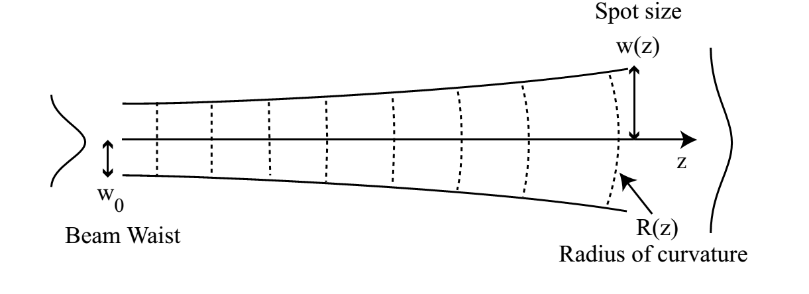
Rewrite the expression of the field

Slide 10
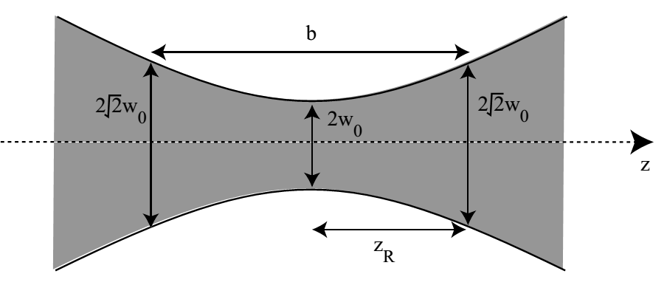
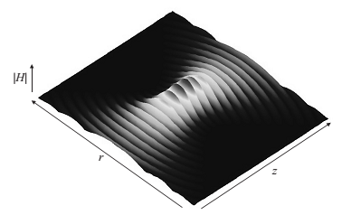
Gaussian beam

Slide 11
Questions?

Slide 12
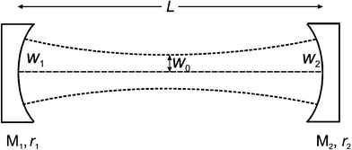
Optical Cavity

